Slide 1



ADVANCED CYBERSECURITY PROGRAMME
FOR LEADERS
10 WEEKS + ONLINE GIM NETWORK
LEARN FROM ONE OF THE TOP B-SCHOOL IN INDIA
INTEGRATED WITH GENERATIVE AI
IN COLLABORATION WITH

Slide 2
Programme Overview
The global cybersecurity market is set to grow significantly—from $183 billion in 2024 to $292 billion by 2028—driven by a rising wave of cyber threats impacting critical systems and services around the world. As these threats grow in scale and complexity, there is a soaring need for skilled cybersecurity leaders who can detect, prevent, and respond to attacks effectively.
In response to this urgent need, GIM has partnered with BlackPerl to launch the Advanced Cybersecurity Program for Leaders, a forward-looking initiative designed to equip professionals with the skills to lead in this evolving landscape. The program integrates cutting-edge topics like Artificial Intelligence (AI) and Generative AI, enabling participants to strengthen their organization’s cyber resilience.
This intensive program offers a well-rounded curriculum that covers key areas such as cybersecurity governance, risk and compliance, and the strategic use of AI for smarter decision-making. It’s designed to empower you with the knowledge and leadership capabilities needed to build strong cybersecurity teams and take on high-impact roles in the industry.
According to IBM's 2023 Cost of a Data Breach Report, the global average cost of a data breach reached $4.45 million—a 15% increase over three years. Alarmingly, 51% of organizations are planning to increase security investments in areas like incident response, threat detection, and employee training, indicating a growing urgency to mitigate risk.

Slide 3










Programme Summary
Institute Name
Duration
Cost
Learning Mode
Weekly Effort
GIM
10 Weeks
INR 50,000 + GST
Online
8 to 10 hours
Faculty
Industry Expert
Program Leader
Eligibility
Certificate
GIM Faculty
Senior Industry Practitioner,
C-Suits
Upon Successful Completion
of the Programme,
Participants Will Be Awarded a Verified
Digital Certificate From GIM & BlackPerl
Subject Matter Experts/
Mid-industry Practitioners
Any Graduate/ Diploma Holder
Live Class/ Instructor Led
Lifetime Recording Access
Co-Hort Based Learning
Great the best learning experience, Nothing
Is better than Live Class
Re-watch any lesson/concept for deeper
understanding
Networking and community interaction by
using discussion boards
Gain Live Project Experience
Focus on Practicals
Don’t only learn, apply them in Customer Project
Enhance your skills under Industry mentorship
Learn by doing, the whole course is divided
By 70% practical experience

Slide 4

Industry Overview
As cybersecurity rises on the risk and leadership radar, GIM has launched the Advanced Cybersecurity for Leaders programme integrated with AI and Generative AI to help you safeguard your business against the escalating frequency and sophistication of cyber attacks. This strategic choice programme offers a pathway to a high-growth career as a cybersecurity leader by teaching you how to become proactive and versatile in this dynamic field.
Cybersecurity is no longer a choice but a strategic imperative for today’s leaders. With the threat landscape becoming more complex and persistent, organizations are significantly ramping up their security investments. IDC reports that global spending on security solutions—including software, hardware, and services—is expected to surpass $219 billion by 2024, reflecting how central cybersecurity has become to long-term business resilience and risk management.
A recent analysis by McKinsey & Company highlights a significant acceleration in cybersecurity investment, with global spending on security products and services projected to grow at an annual rate of 13% through 2025. This marks a notable increase from the 10% average annual growth seen over the past several years, reflecting how rapidly organizations are prioritizing cybersecurity in response to the evolving threat landscape and increased digital transformation efforts.

Slide 5


52%
OF PUBLIC ORGANISATIONS REPORT THAT SKILLS AND RESOURCING ARE THEIR BIGGEST CYBER RESILIENCE CHALLENGES.
56%
OF LEADERS BELIEVE GENERATIVE AI WILL ADVANTAGE CYBER ATTACKERS OVER DEFENDERS IN THE NEXT TWO YEARS.
31%
DROP IN ORGANISATIONS REPORTING A MINIMUM CYBER RESILIENCE SINCE 2022.
SOURCE: WORLD ECONOMIC FORUM, GLOBAL CYBERSECURITY OUTLOOK 2024

Slide 6
Impact of Emerging Technologies -AI & Cloud on Cybersecurity
PROACTIVE THREAT DETECTION
REDUCED RESPONSE TIME
STRATEGIC ADAPTION
ENHANCED RESILIENCE

Slide 7








Programme Highlight
Real World Case Studies and Business usecases
Mashreq Bank Risk Management
Practical cybersecurity tools
and technologies
Life-time Access to Recorded
Materials
Microsoft Cutting Edge Solution for Risk Mitigation
Live Interaction with Instructors
And Mentors
Fire-Side Chat with Industry Body
Aadhar Security Breach Analysis
Real-world case studies and
business scenarios
1 Industry Visit
Elastic Security AI Solution against Threat Detection
Assessments with real
Project experience
Global Recognition,
Access to Industry network
BlackPerl’s Crisis Management

Slide 8
















Cyber Security Tools and Technologies to be Covered
++Many more Opensource Industry Grade Products and Solutions

Slide 9
Programme Modules
Module-1
Module-3
Introduction to Cybersecurity
Information assets
Cybersecurity risks and threats
Information Security Management System (ISMS) Information Security
Management Objectives: The CIA Triad How information security works
Offensive and defensive strategies
ISMS standards and compliance
ISMS best practices
Building a cybersecurity culture in an organisation
Building a cybersecurity strategy
Cyber Basics- Linux, Networking & Python Scripting
Security Strategy and IT Infrastructure
Developing and implementing a cybersecurity strategy
Writing effective security policies and procedures Security awareness and training programmes
Budgeting for cybersecurity and team
Evaluating risk exposure
Cybersecurity control and operations, identifying threats
Module-2
Regulations and Compliance
India’s cybersecurity laws and regulations
The Information Technology (IT) Act, 2000 Computer Emergency Response Team (CERT-In) Information Technology (Amendment) Act 2008 Information technology rules, 2011
Information technology rules, 2021
Essential practices for cybersecurity professionals
National Cyber Security Policy, 2013, National Cyber Security Strategy, 2020
Digital India Act, 2023, Data protection laws in other countries
National Critical Information Infrastructure Protection Center (NCIIPC) ISO/IEC 27001
Know Your Customer (KYC)- Regulatory framework for financial and telecom sectors in India Risk assessment and mitigation strategies

Slide 10
Programme Modules
Module-4
Module-6
Ethical Hacking
Introduction to Ethical Hacking & Legal Boundaries
Information Gathering & Reconnaissance
Scanning & Vulnerability Discovery
Exploitation & Gaining Access
Web Application Hacking Basics
Post Exploitation, Reporting & Defense
Business Continuity and Disaster Recovery
Business Continuity and Disaster Recovery (BCDR) planning
Benefits of Business Continuity and Disaster Recovery (BCDR)
Activating Business Continuity and Disaster Recovery (BCDR)
Common disaster recovery teams
Disaster classification
Disaster recovery process
Elements of a disaster recovery plan
Business continuity strategies
Timing and sequence of planning activities Business continuity in scenarios of threat BCDR: Some common mistakes to avoid
Internal crisis management
Module-5
Cyber Security Emerging Trends
Overview of Cybersecurity Tools: Firewalls, antivirus software, intrusion detection/prevention systems, and SIEM (Security Information and Event Management).
Emerging Technologies: The role of AI, machine learning, blockchain, and quantum computing in cybersecurity.
Cybersecurity Metrics and Analytics: Measuring and monitoring cybersecurity effectiveness.
Module-7
Ransomware and Malware Analysis
Introduction to Malware Analysis.
What is Ransomware and the trends of attacks of Ransomware
Explore various types of malware and ransomware, how they spread, and ways to protect against them
Gain hands-on experience in conducting malware analysis and incident response to detect and manage cyber threats effectively

Slide 11
Programme Modules
Module-8
Module-10
Proactive Threat Detection, AI in Cybersecurity
Introduction to Threat Detection
Setting Up the Threat Hunting & Analytics Platform
Data-Driven Threat Hunting with Python & Jupyter
Advanced Threat Hunting with Machine Learning
SIEM Integration with Jupyter — Elastic, Splunk & Azure Sentinel Notebooks
Human Factors in Cyber Security
Understanding Social Engineering: Identifying and mitigating human-centric threats.
Insider Threats: Managing risks from within the organization.
Developing Cybersecurity Awareness Programs: Strategies for effective training and awareness.
Leadership in Cybersecurity: Building and managing high-performing cybersecurity teams.
Module-9
Incident Response and Crisis Management
Incident Response (IR): Overview Incident Response (IR): Process
Incident Response life cycle
The do’s and don’ts of Incident Response Incident handling scenario – Ransomware Incident handling scenario – Malware
Incident handling scenario – Phishing Crisis management
Crisis communication and public relations
Incident Response with Splunk, Elastic SIEM
Module-11
Industry-Specific Cybersecurity Challenges
Cybersecurity in Financial Services: Protecting sensitive financial data and systems.
Healthcare Cybersecurity: Safeguarding patient data and ensuring regulatory compliance.
Cybersecurity in Critical Infrastructure: Securing essential services and national assets.
Retail and E-commerce Cybersecurity: Addressing challenges in protecting consumer data.

Slide 12
Programme Modules
Module-12
Module-13
Generative AI and Cybersecurity
Introduction to Generative AI
Increased risks and threats from Generative AI, innovation in cyber attacks
Evolved threat identification through Generative AI
Future of Generative AI and automation for containment and eradication
Building and Managing a Cybersecurity Team
Creating and leading a cybersecurity team
Building and managing talent
Evaluating performance
Delegating responsibilities and tasks Addressing and resolving cultural issues
Module-14
Module-15
Globalisation and Supply Chain Security
Understanding supply chain cyber risks
Causes of cybersecurity risks in supply chain
Supply chain attacks
Inadvertent threats in supply chain
Malicious insider activity
Role of leaders in supply chain cybersecurity
Cybersecurity supply chain risk management
Examples of supply chain cybersecurity responses
Ethics Responsibilities and Future of Cybersecurity
Legal and ethical responsibilities of cybersecurity leaders Evolving regulations and laws
Building long-term cyber capabilities
Emerging threats and technologies
Ransomware case studies, critical infra protection case studies Insider threats
Zero trust architecture
Social engineering attacks

Slide 13
Capstone Project
In this three-part capstone project, learners will step into the role of a cybersecurity consultant. You will be tasked with designing a comprehensive, scalable, and future-proof cybersecurity framework tailored for a small-scale Indian business.
You’ll begin by identifying key risks, designing a cybersecurity strategy, and ensuring regulatory compliance. As the business evolves, the framework will be enhanced by integrating advanced components such as AI, Business Continuity Planning, and Generative AI.
In the final phase, you’ll future-proof the system by addressing emerging technologies, cloud security, supply chain risks, and team design. By the end of the project, you will have developed a real-world cybersecurity blueprint aligned with the needs of a dynamic organisation.
Over the duration of the programme, you will progressively build your project across three key phases:
Part A - Building the foundation Part B - Evolving the strategy Part C - Future-proofing the framework

Slide 14
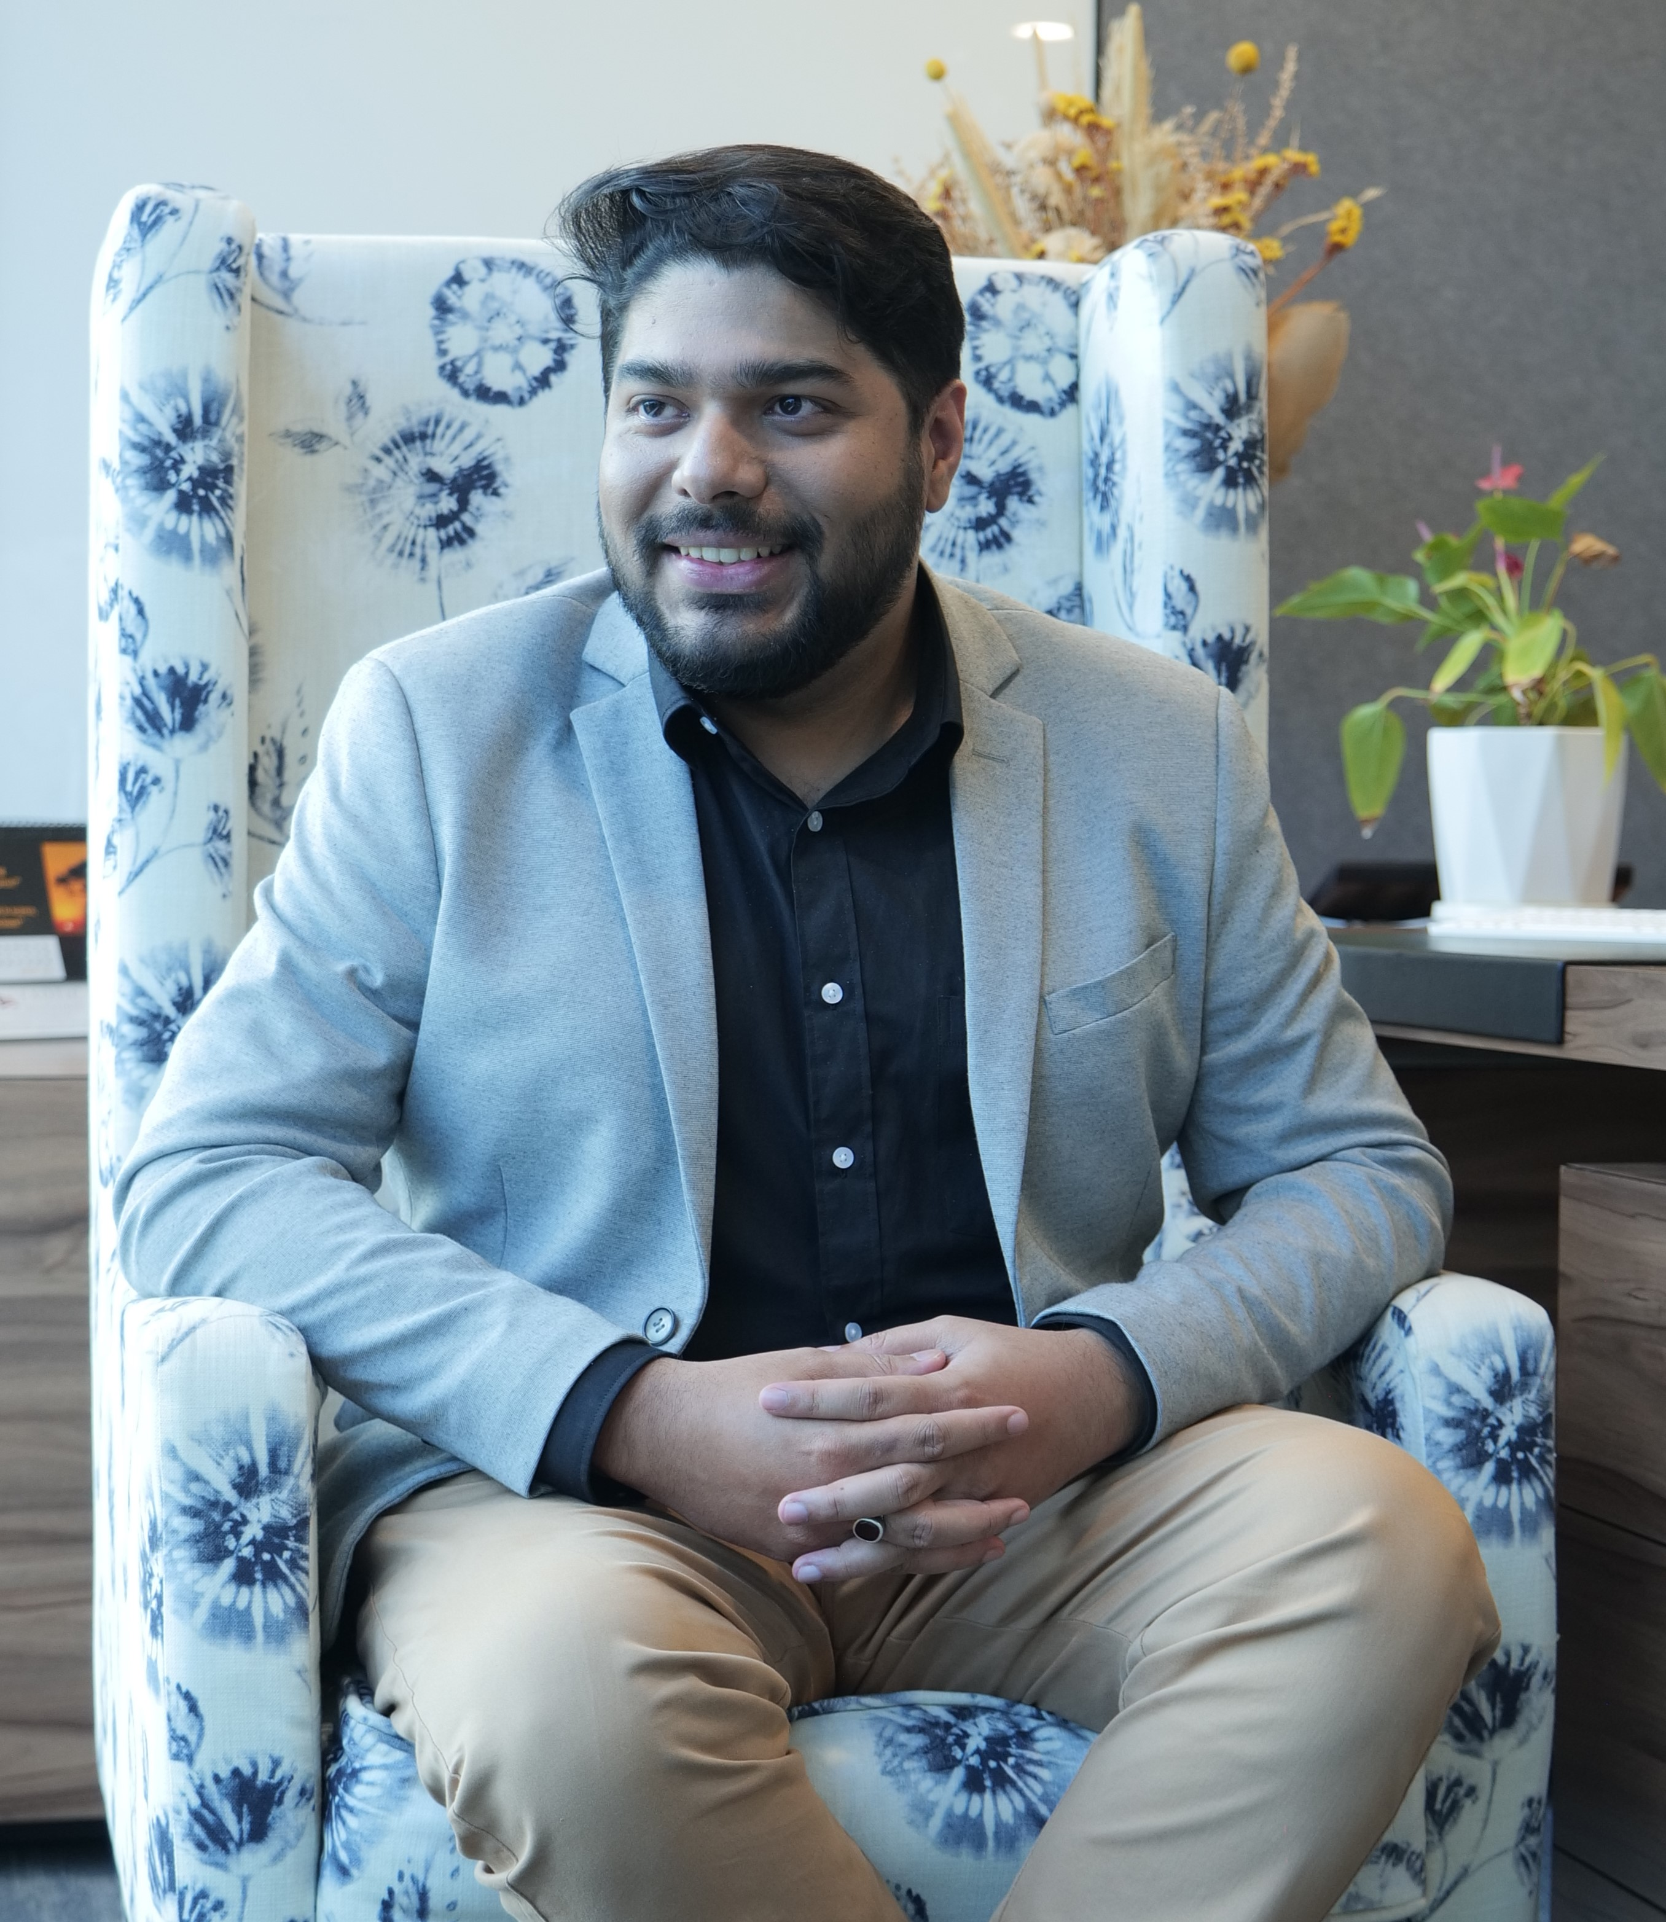
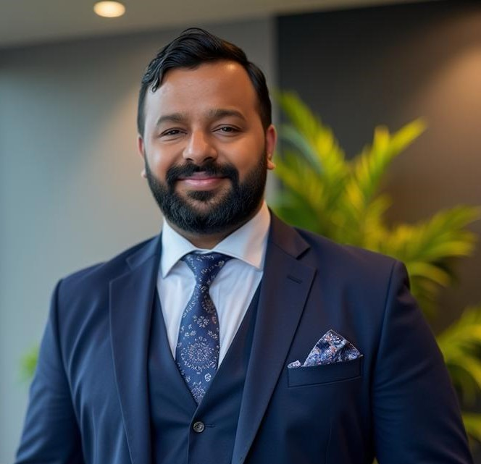

Programme Faculty
Unlike traditional training, we embed industry veterans as faculty—bringing frontline experience from global cyber battles straight into our classrooms. Our unique model integrates practicing industry experts as faculty, ensuring learners gain battle-tested skills that go beyond textbooks and certifications.
Meet the Industry Change Makers
Founder & CEO BlackPerl
Ex-Amazon, Ex-Unilever
Over 15+ Years Industry Experience
Co-Founder & CTO BlackPerl
Cyber Architect over 16+ Years Industry Experience
Founder & CEO TerraEagle
Ex-CISO Unisys, Cyber Global Leader over 22+ Years Industry Experience

Slide 15
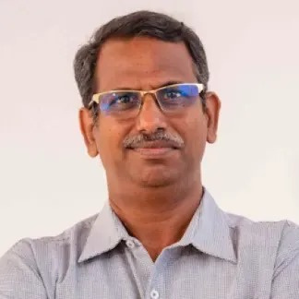
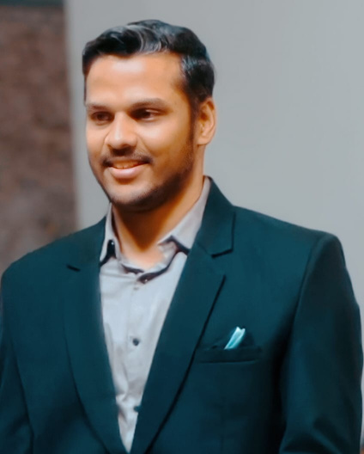

Programme Faculty
At GIM, leadership training is powered by master educators who combine academic rigor with real-world insights, creating an unmatched environment for leadership growth. Unlike conventional programs, GIM integrates globally acclaimed faculty whose proven mastery in leadership development ensures lasting impact on individuals and organizations.
Meet the GIM Change Makers
Associate Professor
Member of IT Council of GCCI
Assistant Professor
Ph.D. from Industrial and Systems Engineering from
IIT Kharagpur
Associate Professor
Ph.D. from IDRBT

Slide 16
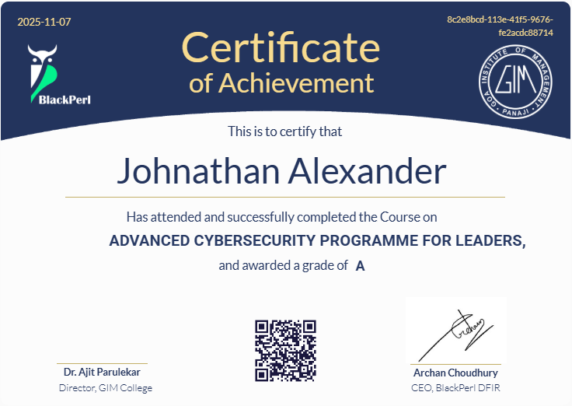
Programme Certificate
Upon successfully completing the programme with a minimum 70% score, you will be awarded a certificate from GIM & BlackPerl DFIR.

Slide 17

Who is this Programme For?
Senior Leaders
Senior leaders who want to develop new applications and frameworks that will need to detect, withstand and counteract intrusion
Aspiring cybersecurity leaders
Aspiring cybersecurity leaders who want to lead security operations and new initiatives in their current organisation
Students transitioning into Cyber Security
Students keen to gain cybersecurity skills and transition to a cybersecurity career
Professionals transitioning into Cyber Security
Professionals keen to gain cybersecurity skills and transition to a cybersecurity career
This programme is tailored to enhance your knowledge of essential principles and optimal methodologies in the field of cybersecurity. It will help you gain hands-on expertise in implementing cybersecurity measures for both immediate and future business strategies, and it will help you engage with consumer data and take responsibility for ensuring compliance with data privacy regulations.

Slide 18
Learning Journey
04
Final Certification Exam
03
Perform the Assessments and Tasks towards Projects
02
Orientation Week
Weekly Goals and Studies
01

Slide 19
About
Goa Institute of Management is a leading business school focused on transforming and improving management education.
Rated among the 'Best B-Schools for the World' in the Positive Impact Rating 2023, GIM endeavours to have a positive impact on the society through its 6 programs getting agile leaders ready for the world.
This year, 21% PGDM Students received PPOs 55 L Highest Package.
Goa Institute of Management is collaborating with BlackPerl DFIR Private Limited to to offer a portfolio of high-impact online programmes. BlackPerl is India’s Only Cyber Education Brand who has trained more than 16,000 students and industry professional in last one year with high quality, industry driven, job ready, practical oriented programmes. Working with BlackPerl gives GIM the advantage of broadening its access beyond their on-campus offerings in a collaborative and engaging format that stays true to the quality of GIM online programme.

Slide 20
Apply for the GIM’s Advanced Cyber Security Programme for
Leaders’ here
Apply Now
Email: cybersecurityonline@gim.ac.in
Contact: +91-9960197556
In Collaboration with BlackPerl DFIR

